Slide 1

Exports and
New Zealand’s Regions
.
EDNZ Conference
Palmerston North
May 2021
.

Slide 2


Slide 3
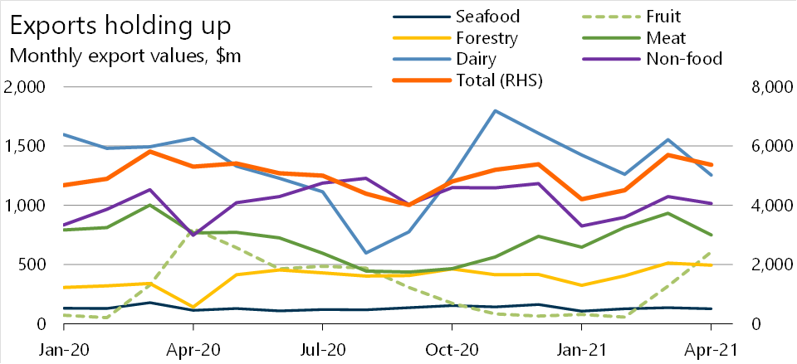
Project analysis slide 2
The world still needs to eat

Slide 4
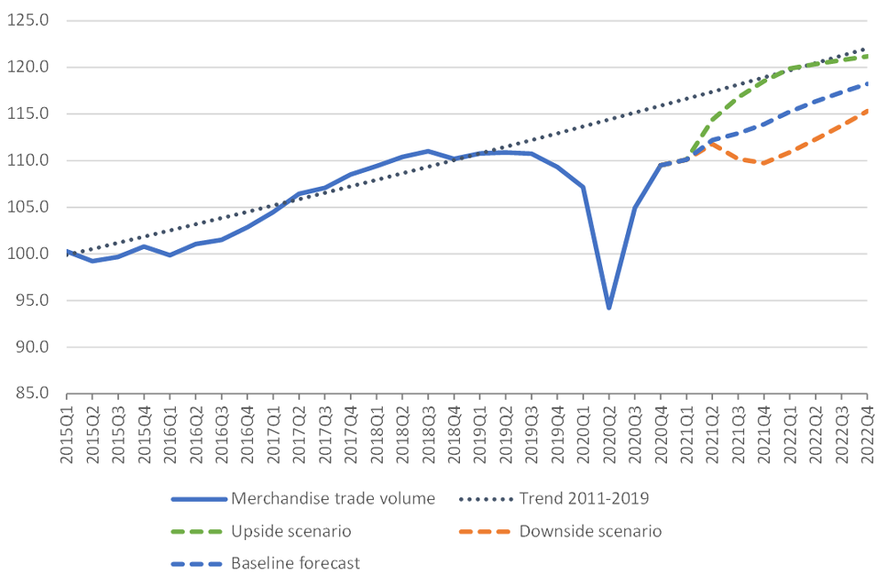
Project analysis slide 2
Global trade is recovering in 2021
Source: WTO 2021

Slide 5
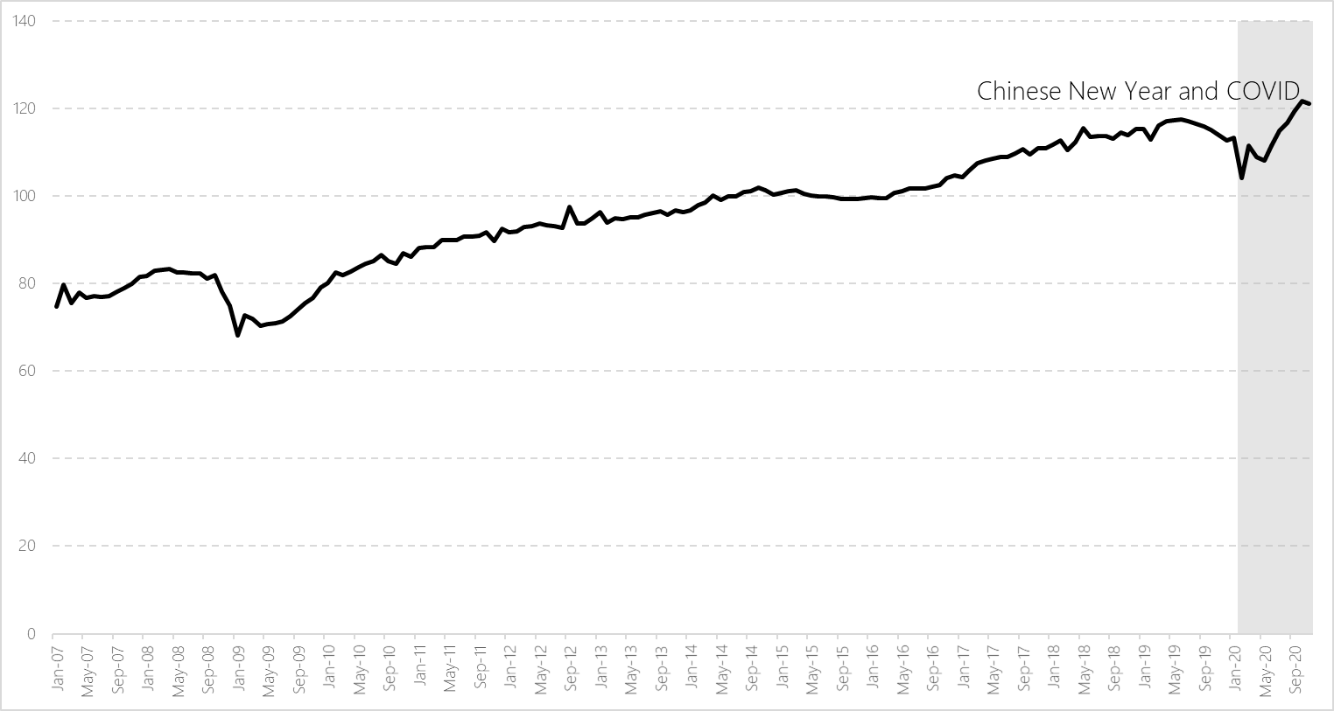
Project analysis slide 2
Global trade is recovering in 2021
Source: Compilation on data from the Institute of Shipping Economics and Logistics

Slide 6
Project analysis slide 2
Transport prices are rising

Slide 7
Understanding regional exports

Slide 8
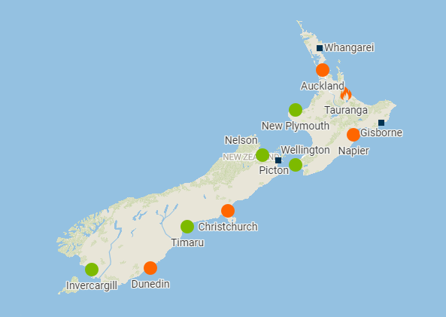
Project analysis slide 2
Understanding regional exports

Slide 9
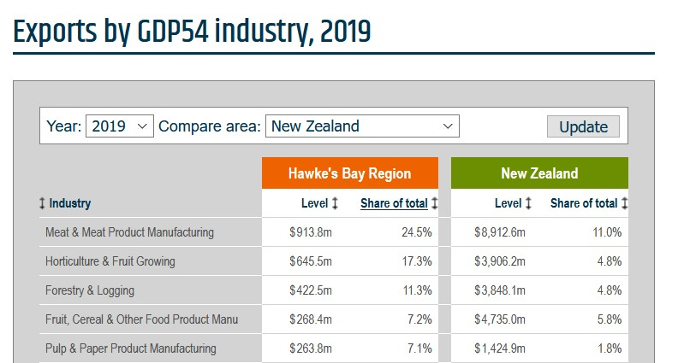
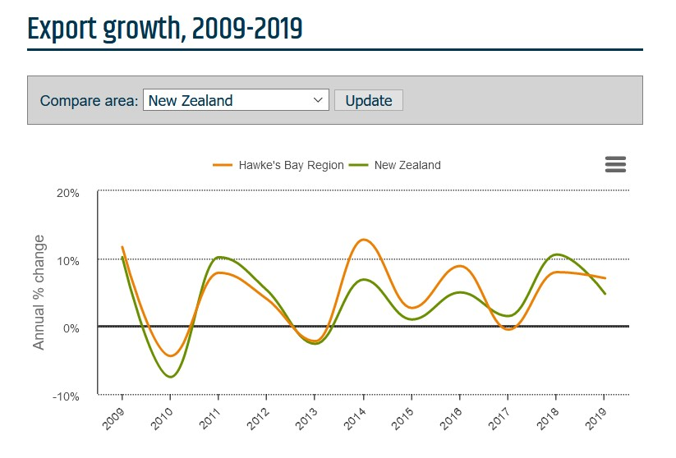
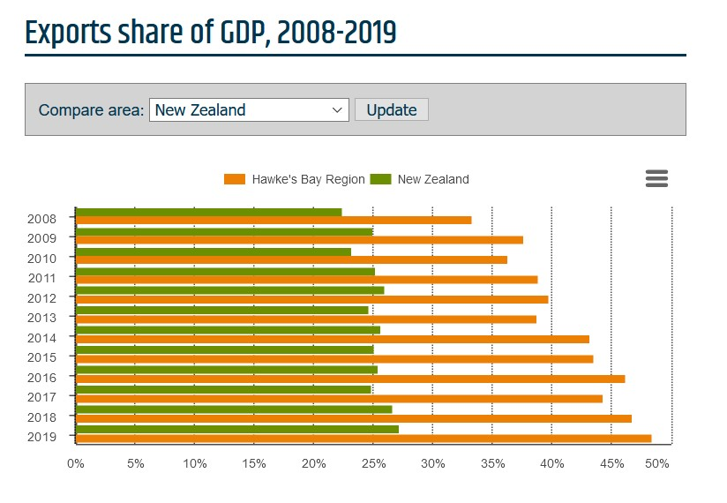
Project analysis slide 2
Investing in export data

Slide 10
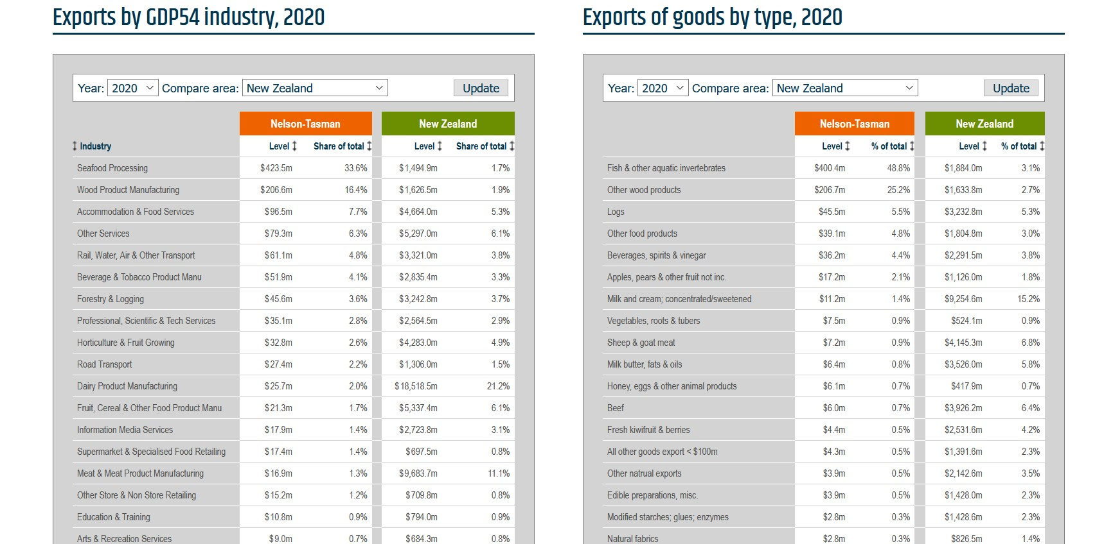
Project analysis slide 2
Investing in export data

Slide 11
What does this mean for exporters in your regions

Slide 12
Project analysis slide 2
China is gobbling up our exports

Slide 13
Project analysis slide 2
Fundamental questions for regions
Our region produces this basket of goods & services
Which products have the greatest potential for growth, and in which markets?
What does this mean for investment decisions in our region?

Slide 14

Project analysis slide 2
Growth is good but so is market diversity
Export growth
Revenue for exporters
Jobs and incomes
GDP growth
Regional investment
Market diversity
Economic resilience

Slide 15

Project analysis slide 2
Infometrics Export Market Finder

Slide 16

Project analysis slide 2
New Zealand’s additional export potential

Slide 17

Project analysis slide 2
Finding new markets
Businesses are experts in their products and markets
but
Big data can give a different perspective
It shows the global picture
Measures untapped potential
Helps identify the unusual suspects

Slide 18

Project analysis slide 2
Lots more in the report
www.infometrics.co.nz/reports/export-market-finder-report-2021

Slide 19
Alistair Schorn – Senior Economist alistair.schorn@Infometrics.co.nz
+64 27 527 7133

