Slide 1
The Importance of Place and Place-based Policies
David Wilson
EDNZ Conference Palmerston North 27, 28 May 2021

Slide 2
4 things
Subsidiarity
Place
Why
How

Slide 3
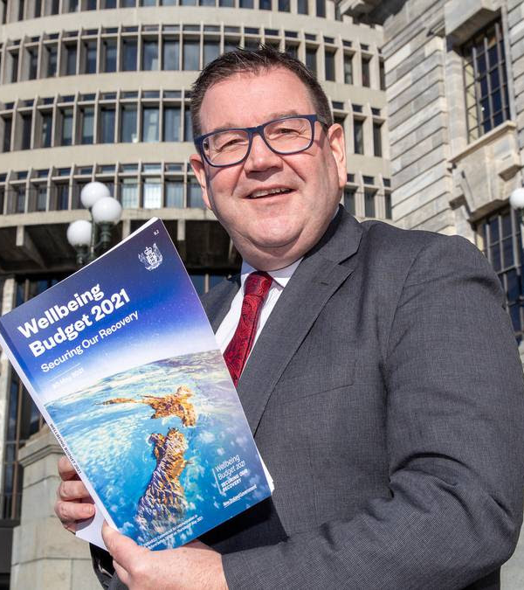

Slide 4
Subsidiarity
The Collins English dictionary: ‘a principle of social doctrine that all social bodies exist for the sake of the individual so that what individuals are able to do, society should not take over, and what small societies can do, larger societies should not take over.‘
Reid (2017, p.18) adds that the principle of subsidiarity means that ‘the provision of services and the solution of problems should take place as close to the citizens as practicable as the nature of the relevant process allows subject to allocative efficiency…’
Wilson (2020) subsidiarity is applying efforts and resources to where they can have the greatest effect.

Slide 5
Place

Slide 6
Place-based Policy:
‘Place-based policies embody an ethos about, and an approach to, the development of economies and society that acknowledges that the context of each and every city, region, and rural district offers opportunities for advancing well being’
Source: Beer, A et al (2021) Regional Studies Association
https://www.youtube.com/watch?v=Vnk6br-byDQ

Slide 7
Spatially Blind Vs Place-Based policies
National focus, centralised policies
Free markets, industry, sector development
Resources to drive technological innovation
Labour mobility Large cities as growth engines
Devolution of policies and $ seen as a risk to Govt
City, Region and Community focus
Strategic support for places
Labour embeddedness
Dispersed growth
Growth for all
Inequality seen as a risk to growth
Do we have Convergence or Divergence?
Adapted from: Beer, A et al (2020), Regional Studies Policy Impact Books, 2:1, 3, DOI: 10.1080/2578711X.2020.1783891

Slide 8
Spatially blind policy areas?
RBP?
Frontier firms?
Industry policies?
Small business?
Innovation?

Slide 9
Place-based policy and development: Core elements
Governance
Leadership
Community wellbeing
Places
Source: Beer, A et al (2020), Regional Studies Policy Impact Books, 2:1, 3, DOI: 10.1080/2578711X.2020.1783891

Slide 10
‘The Tragedy of Faltering expectations’
Vision
Challenge
Policy solution
High hopes
Inadequate Governance Capacity
(hollow)
Action on
Disappointment
Source: Beer, A et al (2020), Regional Studies Policy Impact Books, 2:1, 3, DOI: 10.1080/2578711X.2020.1783891

Slide 11
Success factors: (abbreviated)
An explicit focus on place
Engage with local institutions
Focus on governance
Emphasise value creation and the local capture of value
Consider the performance of places over a long timeframe
Prioritise assistance (for whom adjustment is most challenging)
Accept there is an emotional dimension
Output an outcome measures
Demonstrable, significant achievements built into program design
Embrace goals and aspirations from inception
Webinar: https://www.youtube.com/watch?v=Vnk6br-byDQ

Slide 12
Beer et al Recommendations:
Governments need to:
develop better place-based policies because governmental frameworks that rely on spatially-blind policy settings will leave too many cities and regions behind
‘join the dots’ and recognise that successful place-based policies are multi-dimensional, and programs will be successful if they consider our 10 determinants of success
recognise that how they implement place-based policy is as important – if not more important – than what is implemented
acknowledge they cannot achieve their goals if they fail to take the community with them. Local leaders need to be an integral component of all place-based policy designs and implementation
https://www.youtube.com/watch?v=Vnk6br-byDQ

Slide 13
Place-based Innovation
Government R&D and Innovation policies not only favour frontier firms, they also favour frontier regions and that 'Inequality and regional disparities may inadvertently be accentuated by traditional innovation policies.' In the midst of this there is a lack of understanding of the difference between R&D and innovation in a technology/science-based approach which misses product, service, marketing, and process innovations but more importantly transformative agendas and mission oriented innovation. "The ambition to achieve a particular type of economic growth (e.g. smart, inclusive, sustainable, etc.) embraces the idea that economic growth has not only a rate but also a direction.’
'This report highlights the need for a broad-based approach to innovation policy to unlock the innovation potential of all types of regions and cities… taking capacity of the regional innovation system into account and adapting efforts across all levels of government to work with and upgrade that capacity.
OECD (2020), Broad-based Innovation Policy for All Regions and Cities, OECD Publishing, Paris,
https://doi.org/10.1787/299731d2-en.

Slide 14
Innovation happens ‘face to face in a place’
‘Place continues to matter hugely to innovation and we see this in countless ways in our cities and regions. Places allow research to spill over into enterprise in neighbouring buildings. They encourage a large company’s innovative suppliers to learn from each other and develop new solutions together. They provide the kind of space layouts and affordability for start-ups to find their feet. They give institutions the chance to be close by for mutual advantage. They provide access for more people to take part in innovation and believe in its benefits. They give companies in weaker performing regions more ways to absorb and apply new ideas. Successful places deliver on many core national and local goals.’
Source: Moonen, T. Gille, B. and Harriet Seymour (2021) ‘Hubs of Innovation: A Playbook for Place Leaders’ The Business of Cities for Connected Places Catapult, London.

Slide 15
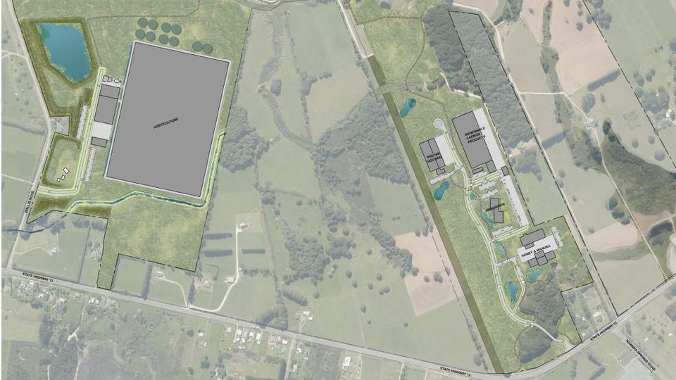
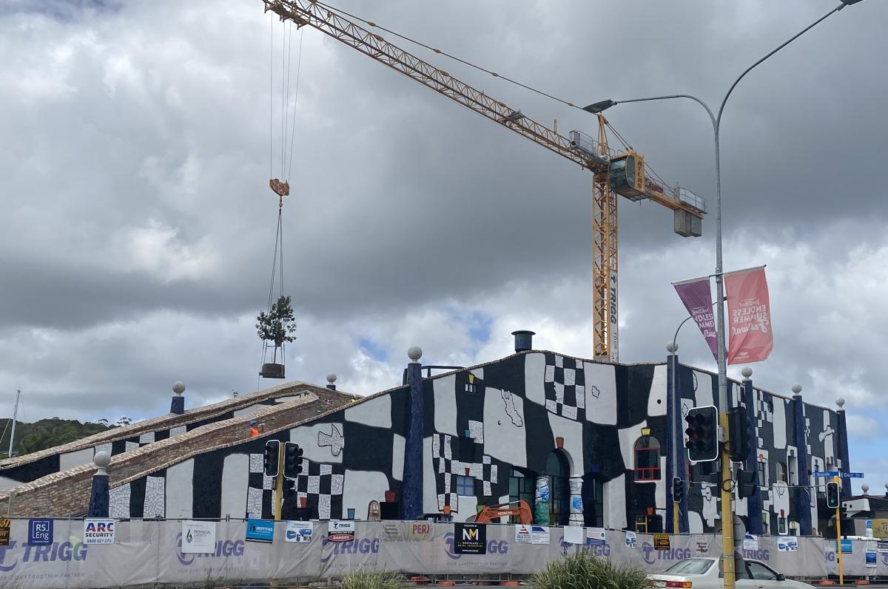
Some Place-based developments
Te Hiku Iwi Development Trust
Ngawha Innovation and Enterprise Park
The Orchard
Hundertwasser Art Centre and Wairau Maori Art Gallery
Manea Footprints of Kupe

Slide 16
People; Connectors, connected, networkers, enablers, facilitators, the heart, the glue… making it happen

Slide 17
Place-based approaches offer the how and the why of success
Possibility
Connection
Emotion
Commitment
Long haul
Governance
Leadership
Policy
Networks
Action

