Slide 1
Impact and responses to covid-19 across otago
The benefits of a collaborative response in a diverse region of differing economies
Presented on behalf of the Otago regional economic development working group by Gerard quinn & Peter harris
EDNZ conference, Palmerston north, may 2021

Slide 2
ContenTS
Introducing ORED
Introducing Otago
COVID impact – economic and people
Response measures
Learnings
Where to from here ?

Slide 3
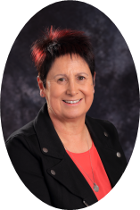
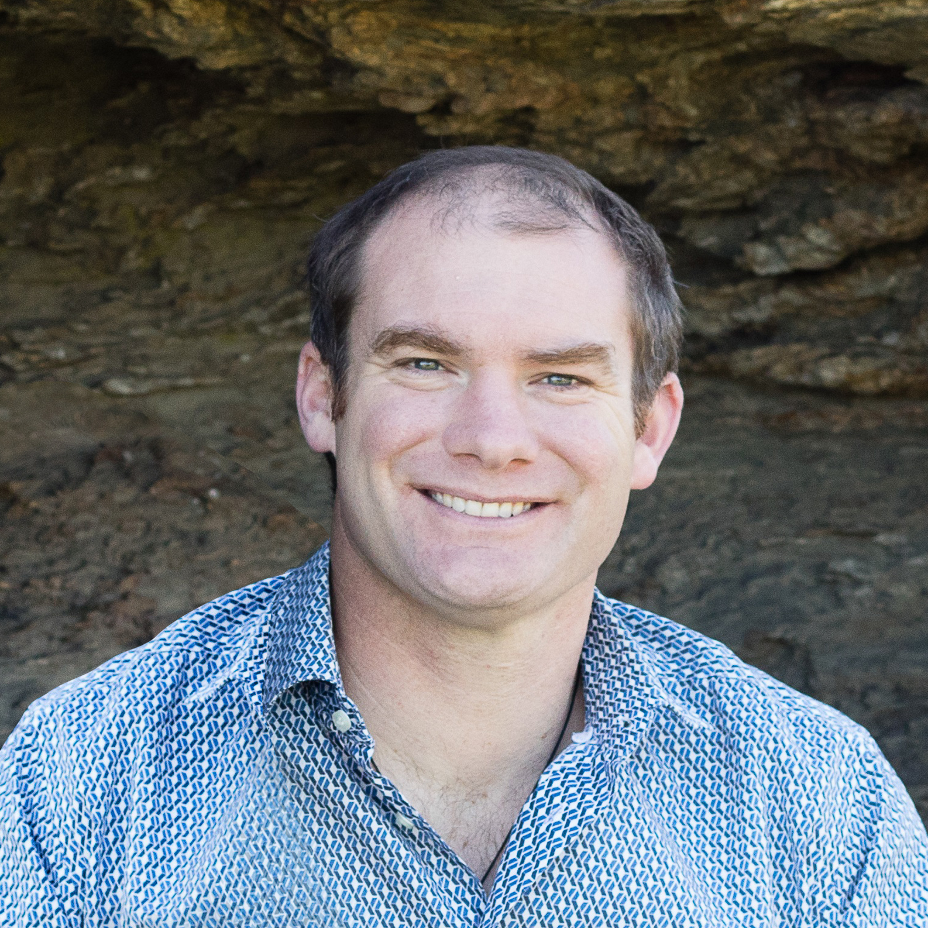
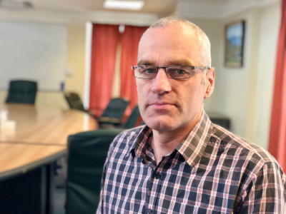
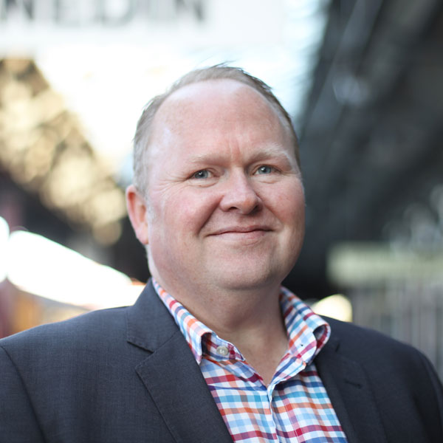
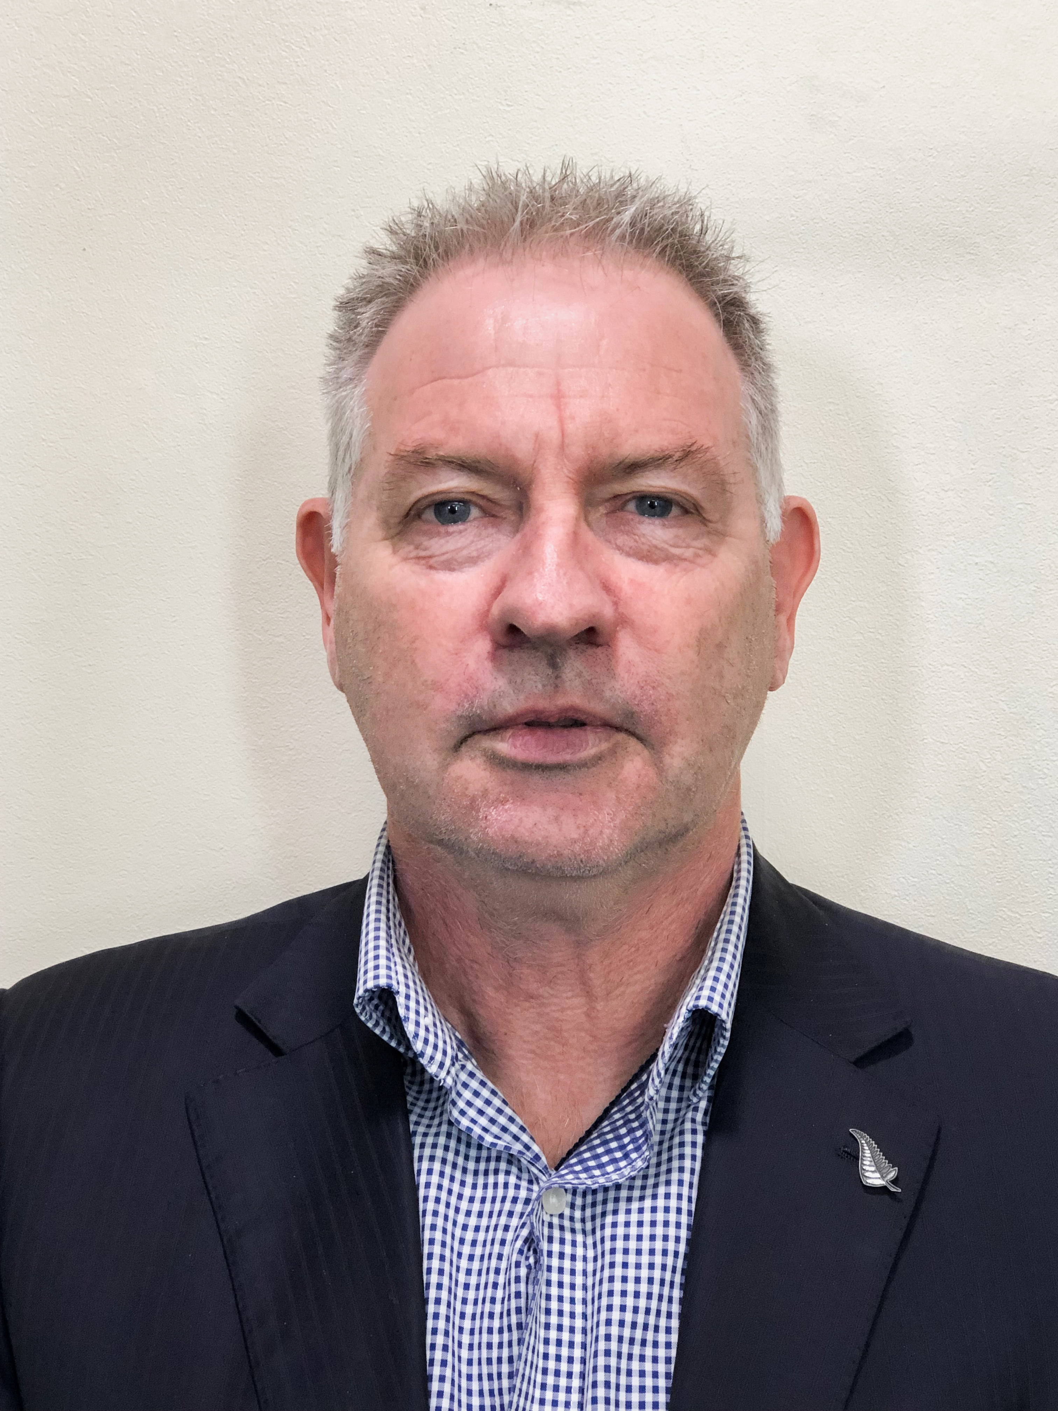
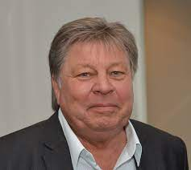
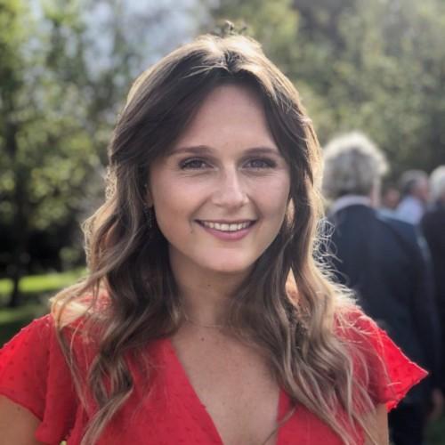
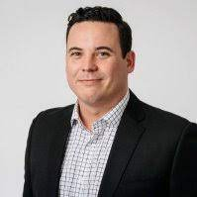
Introducing ORED
A working group
Non-incorporated
Mandated by Otago Mayoral & CE Forums

Slide 4
The ORED Strategic Framework
Initially a response to MBIE desire to fund projects aligned to a regional framework
Purpose is to provide multidistrict benefits from economic development initiatives
through
Greater collaboration that extends more widely than just between districts, but also with iwi, industry, neighbouring regions and central Government.
A prophetic driver for change identified in the Framework:
“Areas of narrow economic focus with potentially low resilience”
And then along came COVID-19 ……

Slide 5
Introducing otago
A region of diverse offerings and diverse economies.
Most kiwis think of Otago as:
Central Otago
Clutha
Dunedin
Queenstown Lakes
Waitaki

Slide 6
Different speed economies
employment Growth by district
GDP Growth by district

Slide 7
BASELINE Economic profilES
 | NZ | QLDC | Waitaki
Population | 5,084,000 | 47,400 | 23,500
Population Growth rate | 2.1 % | 5.8 % | 1.3 %
GDP | $ 322,000 M | $ 3, 430 M | $ 1,859 M
GDP Growth rate Pre COVID | 1.6 % | 4.1 % | 7.2 %
Top 3 industries (GDP) | Manufacturing Professional, Scientific & Technical services Construction | Accommodation & Food Construction Professional Services | Mining Agricultural, Forestry & Fishing Electricity, Gas
Top 3 industries (employment) | Health care & Social Assistance Manufacturing Retail | Accommodation & Food Construction Professional Services | Meat Processing Dairy Cattle farming Gold Mining

Slide 8
COVID-19 IMPACT
Districts with strong exposure to international tourism and private investment are most negatively affected | Queenstown
Those with a focus on food production, processing and public investment are least affected….. | Clutha, Waitaki
….. But with high exposure to foreign labour | Central Otago
And the most diversified | Dunedin

Slide 12
Tourism spend
COVID-19 Lockdown

Slide 13
People needed help to get by

Slide 14
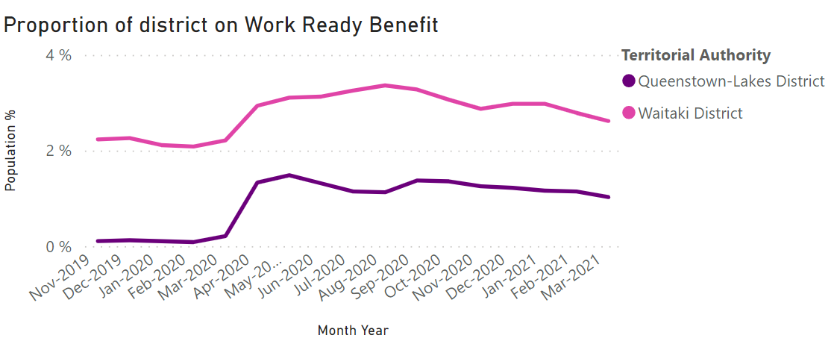
IMPACT FOR PEOPLE ELIGIBLE FOR MSD support

Slide 15
COVID-19 responses
ORED
Districts – almost all did almost all of these
Increased its collegiality and sharing
Deepened the relationship with ORC
Modelled job impact by industry
Advised Councils against nil rates rises
Info centre for businesses and people – CDEM PIM
Rates rise limits
Hardship grants (via CDEM)
Additional dedicated recovery staff
Visitor campaigns
Task Force / leadership groups
Infrastructure fund bids
Buy local campaigns
Support & Stimulus Funds

Slide 16
QL RESPONSES
A seconded team from within QLDC, and collaboration between Chambers, RTOs and ED, and Recovery funding from MBIE created tight teams, and flexibility to respond to changing needs

Slide 17
Lessons learned
Though as EDA managers we experienced very different versions of Covid-19 supporting each other was critical
People are resilient, but as the crisis starts to pass the stress emerges
Don’t expect community consensus - different people have different priorities
Cash poor pragmatics
Cashed up visionaries
“Help me find customers so I can keep my business open”
“Help me find a job so I can pay my bills”
“Tourism must become regenerative”
“Our economy must diversify”
Support your leaders who are ‘vulnerable and valuable’ and make the most of those who step up

Slide 18
Where to from here ?
Queenstown Waitaki
ORED
Regenerative Destination Management
Lifetime value of visitors
Diversification via tapping into talent
NZs best place to futureproof your career
Diversification via value chain expansion
Destination Management
Leveraging assets – e.g. heritage, artisans, lakes, outdoors
Strengthened Iwi partnerships
Leveraging local initiatives for regional benefit
Southland/Otago Technology Alliance

Slide 19
Thank you!
Everything will be peachy,
.... Eventually !
pharris@qldc.govt.nz, gquinn@waitaki.govt.nz
www.ored.orc.govt.nz

