Slide 1

The Way Ahead for Tourism
Chris Roberts, TIA CEO

Slide 2
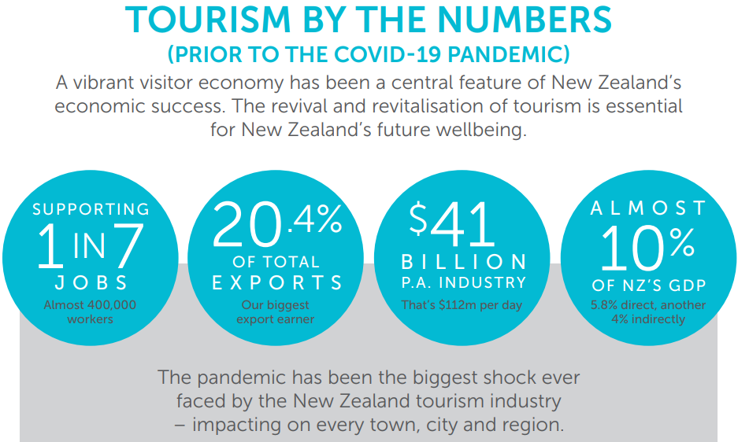

Slide 3

The Pandemic impact in 2020
$17.5b pa in international visitor spend shrunk
40,000+ jobs gone
Small communities reliant on tourism dying
International family and business links disconnected

Slide 4








The ongoing impact in 2021
Visitor expenditure is down $11B*
(now at 2013 level)
Domestic aviation
is operating at
87% capacity
80% of hotel rooms available (but occupancy levels are low for many)
66% of coach operators are still running but at around 10% loading
Sector employment is down 40%
Sector business financial turnover has dropped on average 48%+
Rental car and camper fleets are operating at 45% capacity
International visitation is down 98%
*Excludes airfares, education fees and GST

Slide 5
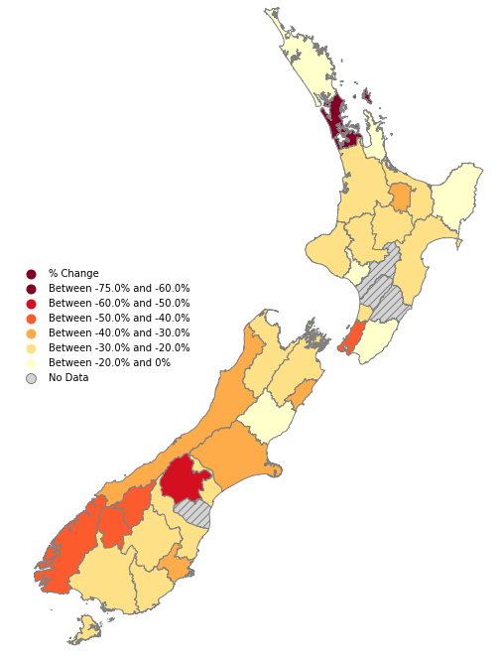
The impacts have not been distributed evenly
... haves and have-nots are appearing
Percentage change in tourism expenditure
Mar 2020 - Feb 2021
All regions have had reductions in overall visitor spend in the past 12 months.
Destinations and businesses that were popular with international visitors have been hardest hit.
Reduction in Visitor Spend
60% – 75%
50% – 60%
40% - 50%
30% - 40%
20% - 30%
0% - 20%
No Data
*Excludes airfares, education fees and GST

Slide 6













TIA Industry Survey April 2021
% DECREASE IN ANNUAL T/O & WORKFORCE DUE TO COVID-19
CURRENT STATE OF TOURISM BUSINESS
  Turnover
  Workforce
-48%
-40%
46%
32%
6%
6%
1%
  Sharply reduced
  As per normal
  Repurposed/
  pivoted
  Hibernated business
  Ceased trading
MAIN IMPEDIMENTS TO RETURNING BUSINESS TO PRE-COVID CAPACITY
LEVEL OF PRE-COVID TURNOVER NEEDED TO BE FINANCIALLY VIABLE
MAIN IMPEDIMENTS TO RETURNING BUSINESS TO PRE-COVID CAPACITY
9%
14%
34%
26%
10%
7%
61%
30%
8%
11%
Minimal
25%
50%
75%
90%
100%
or >
  Labour Availability
  Lack of funds/ capital access
  Availability of plant/equipment
  Sourcing Products
KEY FACTORS FOR A SMOOTH RECOVERY
  Workforce inline with demand: 59%
  Quality of tourism service on offer: 56%
  Price & quality are aligned: 51%
  NZers are welcoming visitors back: 49%
  Physical capacity to meet demand: 39%
  Industry commitment to sustainability: 37%

Slide 8
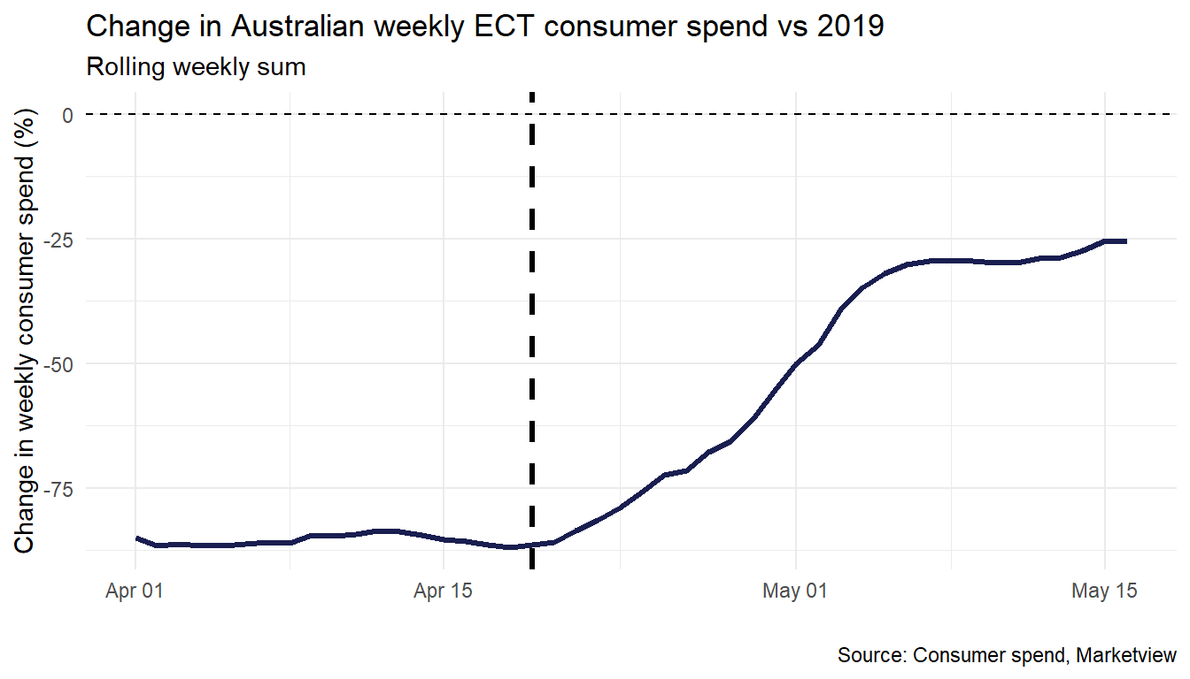
Australian card spend about 70% of normal
Notes:
‘food and liquor’ up 10%
‘home & recreational retailing’ up 3%
‘clothing, footwear & department stores’ up 2%
Tourism-related industries:
‘arts and recreational services’ down 60%
‘transport and travel agencies’ down 54%
and accommodation down 48%

Slide 9
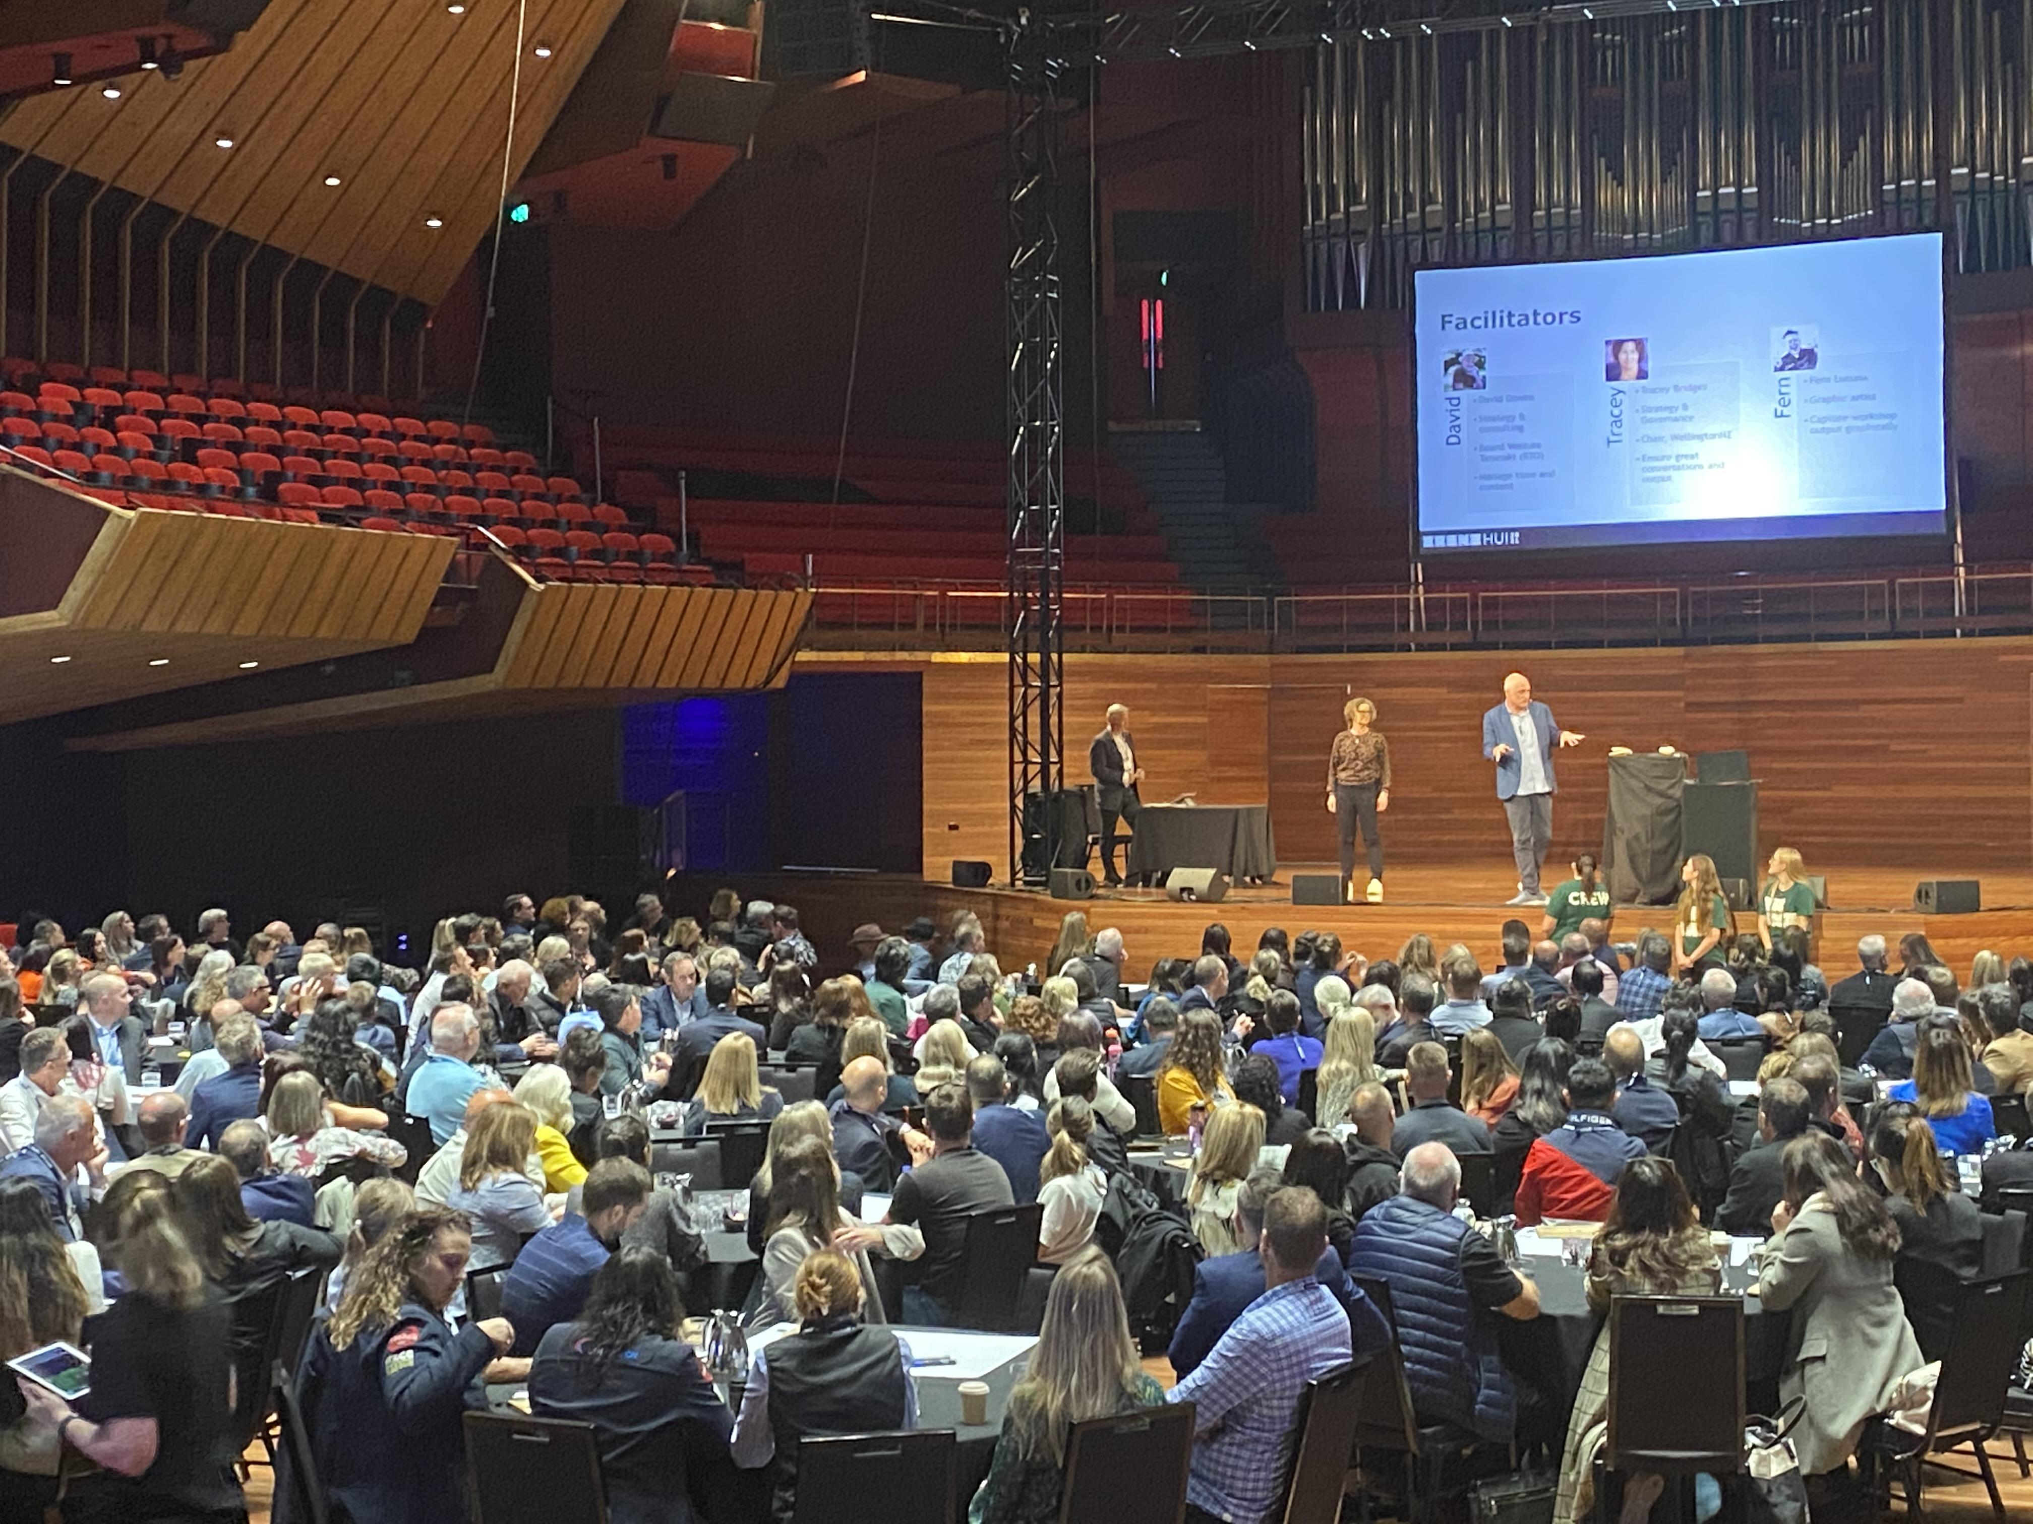
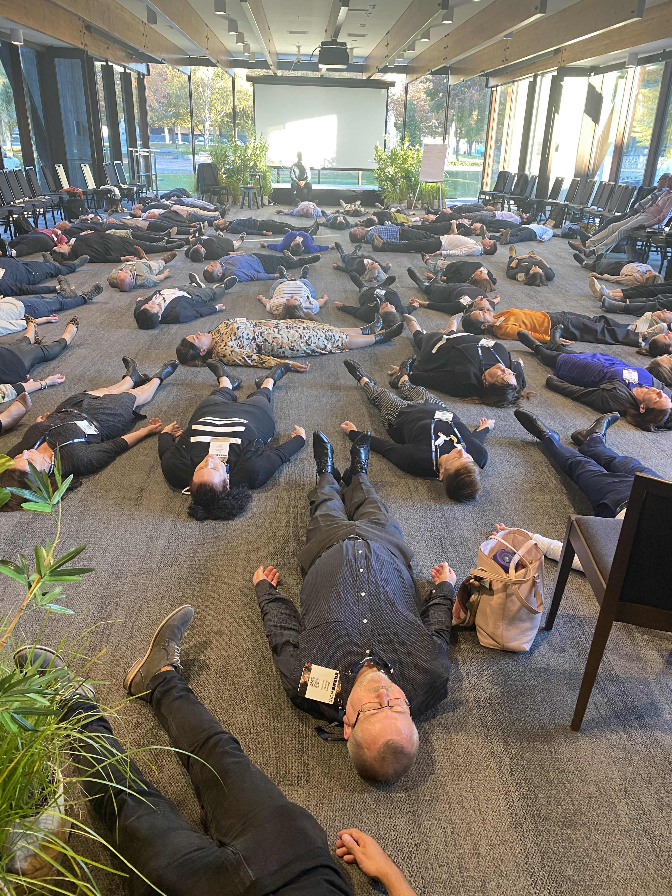
TRENZ Hui 2021

Slide 10
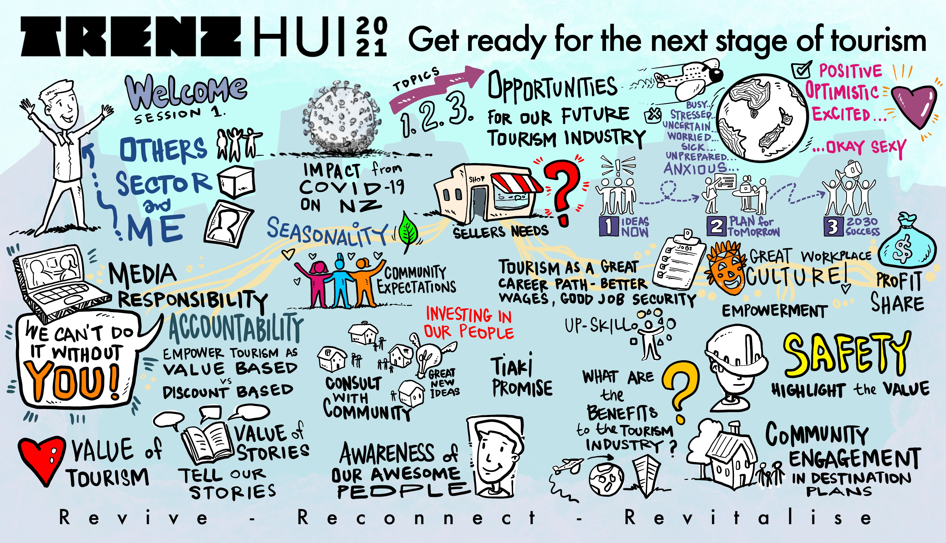

Slide 11

Industry Roadmap
Where are we now?
Where do we want to go?
What are the known and potential speedbumps?
Are there any roadblocks and if so, how do we shift them?
Stocktake, Insights, Scenarios, Interventions

Slide 12
Our recovery path is highly uncertain due to factors we can’t control
Able to scale quickly to meet demand
Turning
the tide
Herd immunity achieved quickly
Returns to pre-Covid state
Travel demand surges post-Covid
FAST RECOVERY
State of the virus globally
State of the virus in NZ
Geo-political situation
Demand for international travel
post-Covid
Global air connectivity and capacity
SLOW RECOVERY
Long global outbreak
Herd immunity not achieved
Changes impede tourism recovery
Change in preferences reduces travel demand
Unable to scale quickly to meet demand

Slide 13
The best forecast we can provide right now is a ‘wedge’
Some recent examples of why we have a wedge:
Situation in India
Melbourne outbreak
Perth/Sydney lockdowns
Brisbane green zone breach
Community cases in Fiji
Slow vaccination rates
Emergence of new variants
‘The Wedge’
range of potential futures
"The ‘wedge’ will narrow as we have more certainty"
"Contingency planning is critical"
  *Excludes airfares, education fees and GST

Slide 14
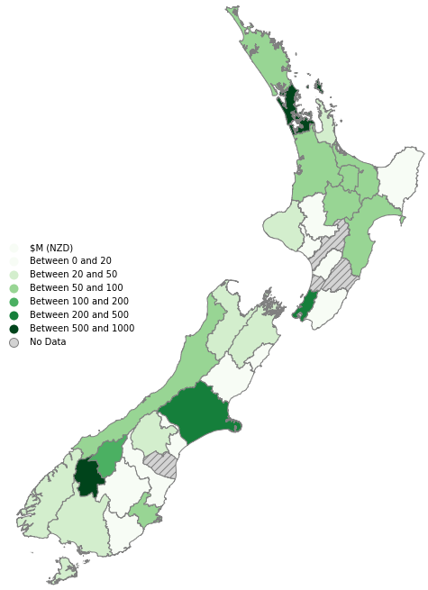
The Australians are coming (but not everywhere)
…and our industry will need more markets and a few more years for a quality recovery
We expect the VFR market to lead AU and leisure to follow, starting with ski, school holidays and long weekends.
Auckland, Queenstown,
Christchurch and Wellington are likely to be most popular
destinations for Australians.
Distribution of spend by Australian visitors in 2019
"For the rest of 2021, bank your school holiday approach (price and occupancy), long weekends and VFR. Then work back from there."
*Excludes airfares, education fees and GST
*Excludes airfares, education fees and GST

Slide 15




Retaining and attracting people will be a significant challenge during recovery
THEME ONE: WORKFORCE
Insights
Industry
employment
is down 40%
Now, access to staff is a key issue
Other sectors are competing for our best remaining staff
Australian businesses are looking to hire Kiwis across the ditch
Wage rates are increasing and the Living Wage is a regular discussion point
The jobs are not where the people are
We cannot rely on
foreign labour
Retaining existing staff will be hard – and attracting new staff into the sector will be even harder due to actual/perceived volatility

Slide 16
Retaining and attracting people will be a significant challenge during recovery
THEME ONE: WORKFORCE
Actions – now
Be an attractive employer
  Move quickly on recruitment
  Pay competitively to secure good people
  Consider one-off incentives (sign on, retention)
  Smart employment propositions such as flexible roles / hours / WFH / learning and development
Create your own hire Kiwis strategy
Lobby Govt to extend visas for migrants already in NZ
Collaborate with other employers in your region
Actions – longer term
Industry to consider working with unions and government to redevelop the employment offer within tourism
Eliminate industry reliance on foreign workers
TIA to survey and monitor employment trends across the sector through recovery
Extend the Go with Tourism programme
Consider technology investments that increase productivity and reduce reliance on people
“Our hiring process used to take four weeks,
now we have accelerated it to one week – and we are offering a sign-on bonus for good candidates”

Slide 17





Customers must have confidence in our product – especially during recovery
THEME TWO: PRODUCT
Insights
Manage customer expectations regarding your current state of service
Market standard is increasingly flexi-date and low or no cost cancellations
Remember that supply is constrained - the industry is smaller than it used to be, and it will remain smaller for some time
Covid Clean is becoming a new customer expectation – for Kiwis and even more so for international visitors

Slide 18
Customers must have confidence in our product – especially during recovery
THEME TWO: PRODUCT
Actions – now
Be honest through all communication channels about your current state, especially with repeat customers
Reduce risk for customers – they will value flexible terms. Consider reviewing your cancellation T&Cs for 2021 on beyond to make them easier for customers.
Covid Hygiene – in place and visible to Kiwis and international visitors.
Action – long term
Industry to seek support from government for capital spend e.g. accelerated depreciation or electrification
“We can’t use Covid as an excuse – put your best foot forward and delight new customers”
“If quarantine-free-travel is interrupted we will do our best to re-book you next month - or offer a refund”
“We need to consider if all elements of the product and value equation are relevant today."

Slide 19



Despite reduced volume, social licence remains fragile in a post-Covid world
THEME THREE: SOCIAL LICENCE
Insights
NZ
Kiwis loved having NZ to themselves in our bubble
As well as the old fear of “too many tourists”, we now also have a new “fear of Covid”
and a wariness of change
Infrastructure concerns may not be able to be addressed as Government faces fiscal hole
Unsafe driving, “toileting issues” and traffic congestion are still a thing with domestic only – but that doesn’t mean Kiwis will welcome international visitors with open arms
There will be no lessening of community and government focus on social license issues, even though our sector is doing it tough. Recovery may add more challenges in the near term
"Inclusion and participation in domestic tourism
drives economic resilience - and social licence"

Slide 20
Despite reduced volume, social licence remains fragile in a post-Covid world
THEME THREE: SOCIAL LICENCE
Actions – now
Continue to welcome domestic visitors – particularly local community
Encourage Govt to continue TNZ domestic mandate
Align your brand and values with your community
  Embrace local culture and values authentically
  Make your community proud – do well by doing good
Encourage your customers to embrace Tiaki Promise
Participate in destination management planning (DMP) processes through your Local RTO
Actions – longer term
Implement outcomes from Responsible Camping reform
Engage with central and local government on shared infrastructure and funding models
Define what we mean by 'value’ – agreed set of measures with industry and government
Expand Tiaki Promise approach – deliver to four capitals
Commit to a sustainable future:
  TIA Sustainability Commitment
  Transition to low carbon
“We had too many… now we don’t want any”
“It is our responsibility to ensure that visitors contribute positively to our communities”

Slide 21
Roadmap for businesses (individual actions)
WEDGE =
uncertain recovery
Haves and have nots =
UNEVEN Recovery
WATCH
WEDGE UPDATE | ROLLERCOASTER DIPS | AU LEISURE
ACT
SOCIAL LICENCE
WORKFORCE
PRODUCT
Be an attractive and flexible employer
Create your own hire Kiwis strategy
Collaborate with other employers in your region
Be honest through all communication channels about your current state
Reduce risk for customers
Covid Hygiene – in place and visible to Kiwis and international visitors
Continue to welcome domestic visitors – particularly local community
Align your brand and values with your community
Encourage your customers to embrace the Tiaki Promise
Participate in local DMP processes
Be an attractive and flexible employer
Create your own hire Kiwis strategy
Collaborate with other employers in your region
ENSURE
React to the wedge and plan for all scenarios

Slide 22
Roadmap for the industry (group actions)
WEDGE =
uncertain recovery
Haves and have nots =
UNEVEN Recovery
WATCH
5 EXTERNAL INDICATORS | GOVERNMENT ACTIONS | TRAVEL TRENDS
ACT
WORKFORCE
PRODUCT
SOCIAL LICENCE
Lobby government to extend visas for migrants already in NZ
Monitor and report employment trends
Extend Go with Tourism programme
Work with unions and government to redevelop the employment offer
Industry to seek government incentives for capital spend e.g.
  Accelerated tax depreciation
  Electrification of fleets
Encourage govt to continue TNZ domestic mandate
Implement outcomes from Responsible Camping reform
Engage with government on shared infrastructure and funding models
Define what we mean by 'value’ with industry and government
ENSURE
Industry leads action and sets the recovery path

Slide 23
