Slide 1
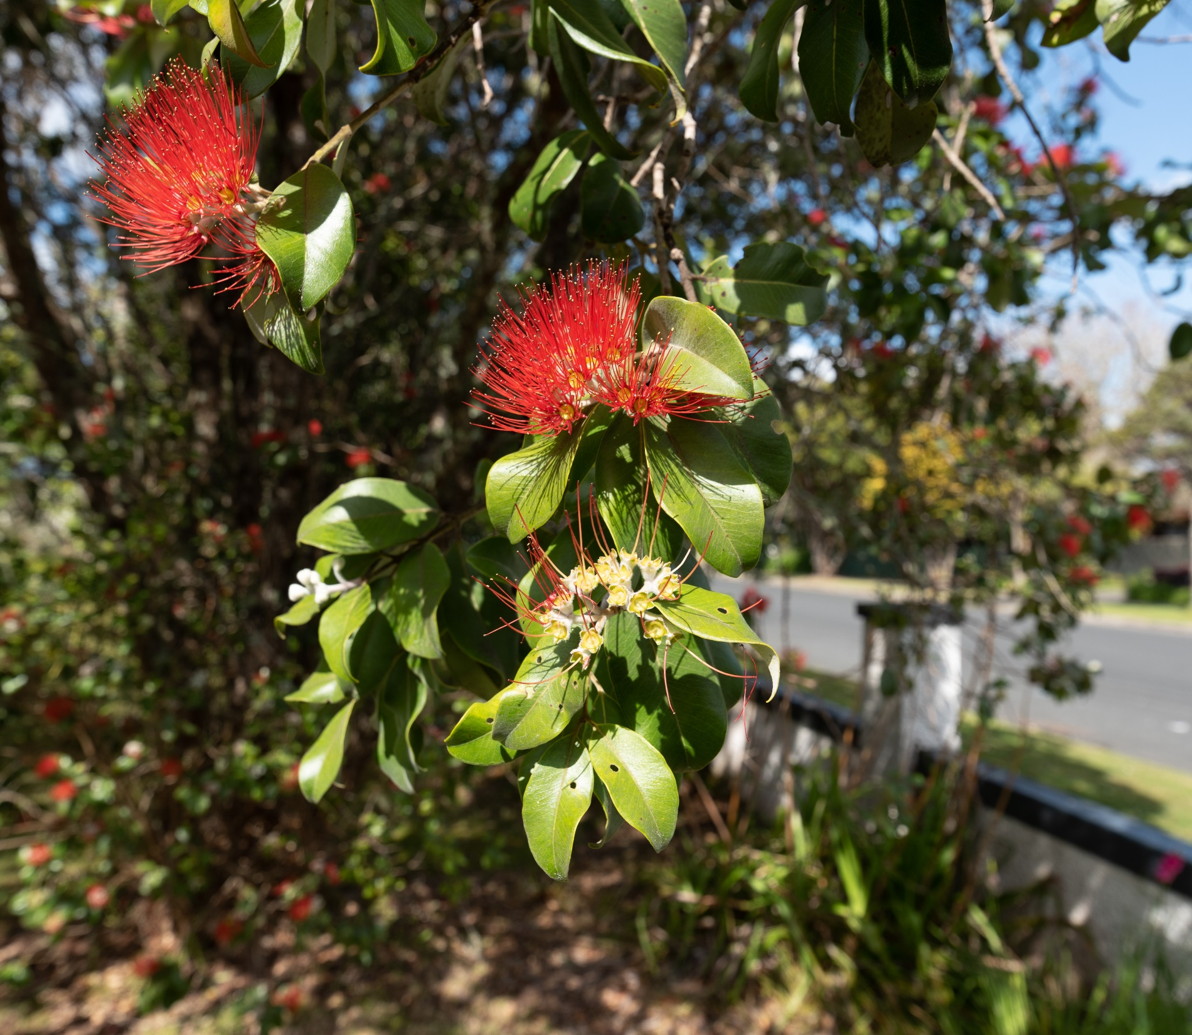
Understanding the housing challenge, and the role of Kāinga Ora in partnering with communities to respond
27 May 2021
Mark Rawson
Regional Director Waikato
Notes:
Key Question?
What is the role / opportunity for regional economic development in enabling solutions to the Housing crisis.
Intro KO
Who
Continuum
What is the challenge?
Hud challenges
What are we doing about it?
Our products / tools
Examples
Sleepyhead
? Enderly ….
Gaps
Across continioum (invest plan preso)
Demand
Shorten up products
Why interested?
RIP’s – ED opportunities
Link people & jobs

Slide 2
Notes:
We own or manage approx. 66,250 state homes
Value of our portfolio: $30.8b
FY 18/19 maintenance costs: $521m
38% of our homes have three bedrooms
45% of our homes are located in Auckland

Slide 3
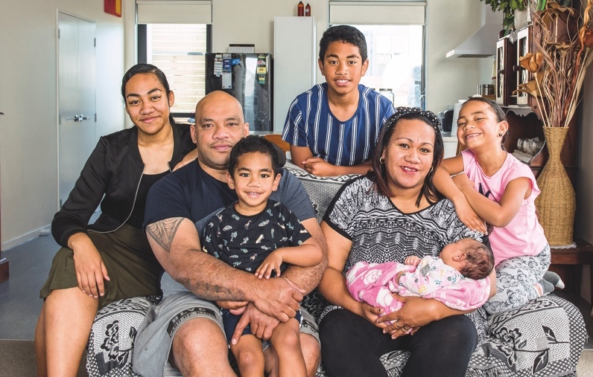
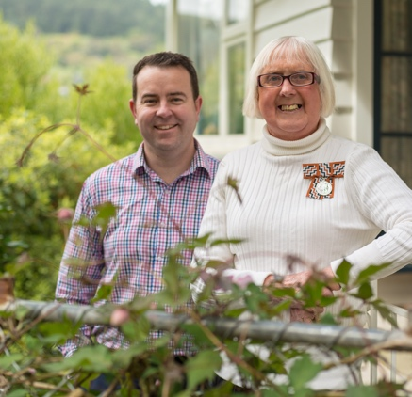
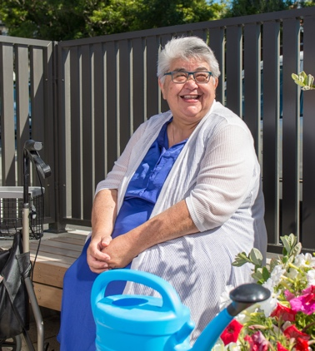
Kāinga Ora – Who are we?
Established October 2019
Brings together people, capabilities and resources of KiwiBuild, Housing New Zealand and its development subsidiary HLC
The creation of Kāinga Ora brings a more cohesive, joined-up approach to supporting the Government’s priorities for housing and urban development
Kāinga Ora supports people across New Zealand to have good quality, affordable homes, and live in strong, healthy communities
Two key roles
Being a world-class public housing landlord
Partnering to lead and facilitate urban development projects of all sizes
Notes:
We own or manage approx. 66,250 state homes
Value of our portfolio: $30.8b
FY 18/19 maintenance costs: $521m
38% of our homes have three bedrooms
45% of our homes are located in Auckland

Slide 4
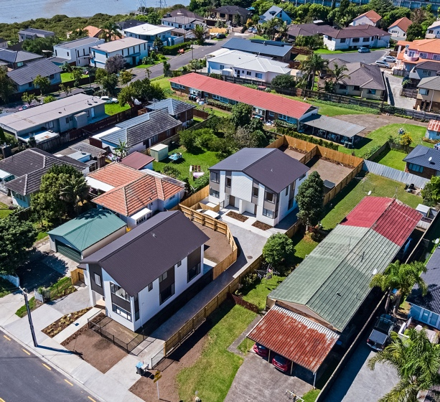
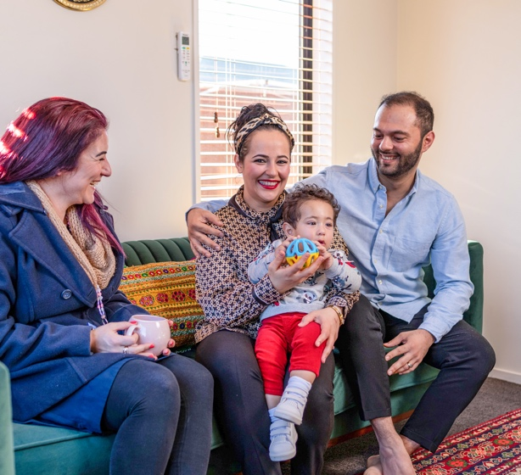
NZ’s largest public landlord
We own or manage
~66,300
Properties
189,000+
People live in our houses
Which is 4% of New Zealand’s 5.0m population
5,180
Families placed into homes last financial year
Over 98%
Occupancy rate
Value of group assets (FY20)
$30.8 billion
Notes:
NZ’s biggest residential landlord, around 66,000 public homes
More than 7,000 homes in the pipeline for next three years
6 large scale regeneration projects underway
Over 50,000 homes to be delivered within the large scale project areas
Current value of our portfolio: $30.8b
Biggest institutional and legislative change to housing and urban development for a generation.
- Kāinga Ora is leading the largest urban regeneration ever undertaken in New Zealand, a multi-billion dollar programme that will transform suburbs and communities across the country.
- Large-scale developments are currently underway in Auckland’s Hobsonville Point, Northcote, Mt Roskill, Oranga and Mangere. We are also working alongside Tāmaki Regeneration Company to deliver more homes to Point England, Panmure and Glen Innes in Auckland’s east; and we are working in partnership with Porirua City Council and Ngāti Toa Rangatira to undertake a large scale regeneration project in Porirua.
- As well as increasing the supply of new quality housing including more affordable homes, these projects will create improved infrastructure, more connected neighbourhoods and better amenities.
Partnerships will be critical to making this work. Kāinga Ora will partner with developers, councils, community, Māori, government agencies, and others to facilitate and deliver urban development projects.
It’s about transforming whole communities. Development projects will provide people with good quality, public, affordable and market homes that connect to the jobs, transport networks, open spaces and facilities needed for communities to thrive.
Kāinga Ora will also play an essential role in tackling the Government’s priorities of ending homelessness and making homes in New Zealand more affordable.

Slide 5
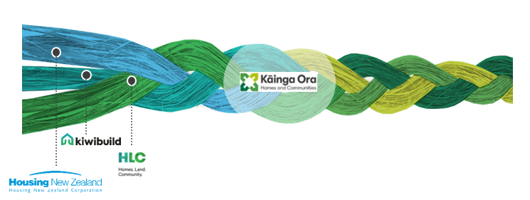
Kāinga Ora’s six key outcomes
The job we’ve been asked to do is broader than just being a social landlord or urban development agency
Communities – We create sustainable, inclusive and thriving communities; supporting good access to jobs, amenities and services
Housing access – We provide good quality, affordable housing choices that meet diverse needs
Māori interest – Partnering with Māori ensures Māori interests are protected and their needs and aspirations are met and allows Kāinga Ora to fulfil its obligations in respect of Te Tiriti o Waitangi
Public housing customers – Our public housing customers live well in their homes with dignity, stability, and the greatest degree of independence possible
Environment – Environmental wellbeing is enhanced and preserved for future generations
System transformation – System transformation is catalysed and delivered
Notes:
Improving New Zealand and New Zealander’s lives
Homes not Housing
Communities
Economic development
Linkage to jobs pathway to independence
Multiple building and architecture industry awards
Built to 6 Homestar or better
Multiproof designs to speed up consenting
Rolling out targets for building relocation, re-use of materials and diversion from landfill
Enabling off-site manufacture industry in New Zealand

Slide 6
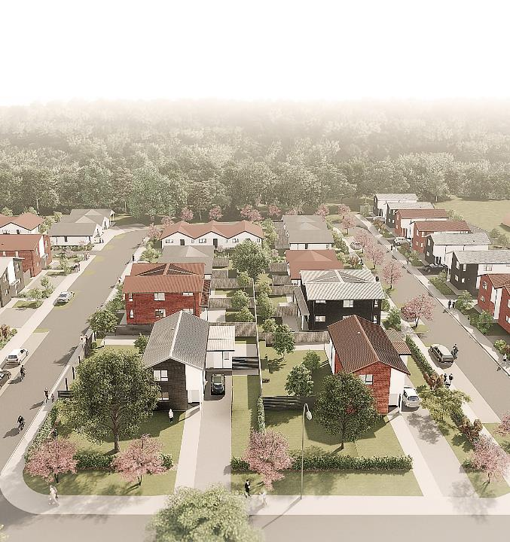
Operating across the housing continuum
Supported Housing
Public Housing
Affordable Housing Supply
Urban Development and Regeneration
Notes:
Biggest institutional and legislative change to housing and urban development for a generation.
Partnerships will be critical to making this work. Kāinga Ora will partner with developers, councils, community, Māori, government agencies, and others to facilitate and deliver urban development projects.
It’s about transforming whole communities. Development projects will provide people with good quality, public, affordable and market homes that connect to the jobs, transport networks, open spaces and facilities needed for communities to thrive.
Kāinga Ora will also play an essential role in tackling the Government’s priorities of ending homelessness and making homes in New Zealand more affordable.

Slide 7
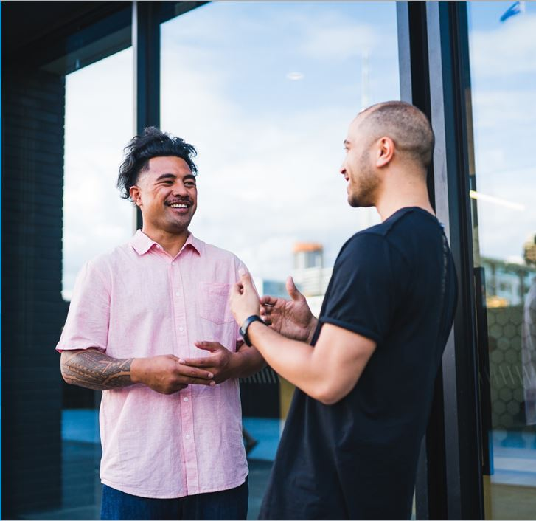
Kāinga Ora’s new structure
Place-based delivery and decision making
12 regions, formed into three super-groups - Auckland & Northland, Central, South Island
Decentralising to regions - operations, community engagement, investment planning
Support from centres of expertise with a nationwide span, including construction, urban development and strategy
Notes:
We are being asked by the Government to do new things than our previous organisations. To do things differently we are changing how we are structured to ensure we best meet housing needs of the communities we serve.
We’re building on our presence and capability in the regions to ensure we are working closer with our customers and communities, Māori groups and iwi, and our partners.
This ‘place-based’ approach means we will manage less centrally and operate closer to our customers, communities and partners. Importantly, we are also building core capabilities to fulfil for our new Urban Development responsibilities, and expand our work with the construction and development industry, and commercial suppliers.
Part of our new ‘place-based’ approach involves the creation of regional leaders who will act as a senior, single point of contact for stakeholders and communities. We call these roles Regional Directors, and they are at the core of our new organisational structure. They are the key contact for the region will co-ordinate and lead the activities of our other business groups.
A key focus throughout this work is partnering with iwi and Māori to improve Māori housing outcomes.

Slide 8
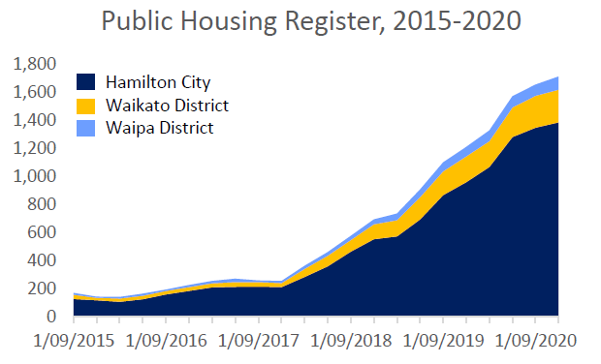
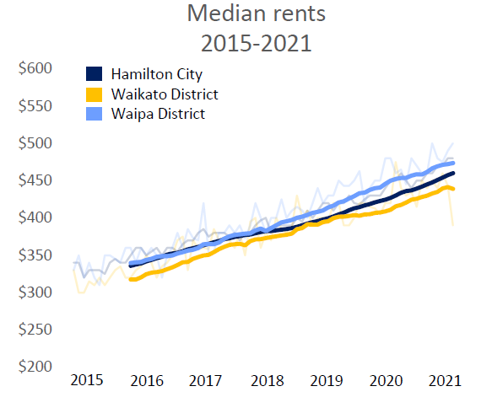
Size of the challenge – Waikato example
Notes:
Replicated throughout NZ
Biggest institutional and legislative change to housing and urban development for a generation.
Partnerships will be critical to making this work. Kāinga Ora will partner with developers, councils, community, Māori, government agencies, and others to facilitate and deliver urban development projects.
It’s about transforming whole communities. Development projects will provide people with good quality, public, affordable and market homes that connect to the jobs, transport networks, open spaces and facilities needed for communities to thrive.
Kāinga Ora will also play an essential role in tackling the Government’s priorities of ending homelessness and making homes in New Zealand more affordable.

Slide 9
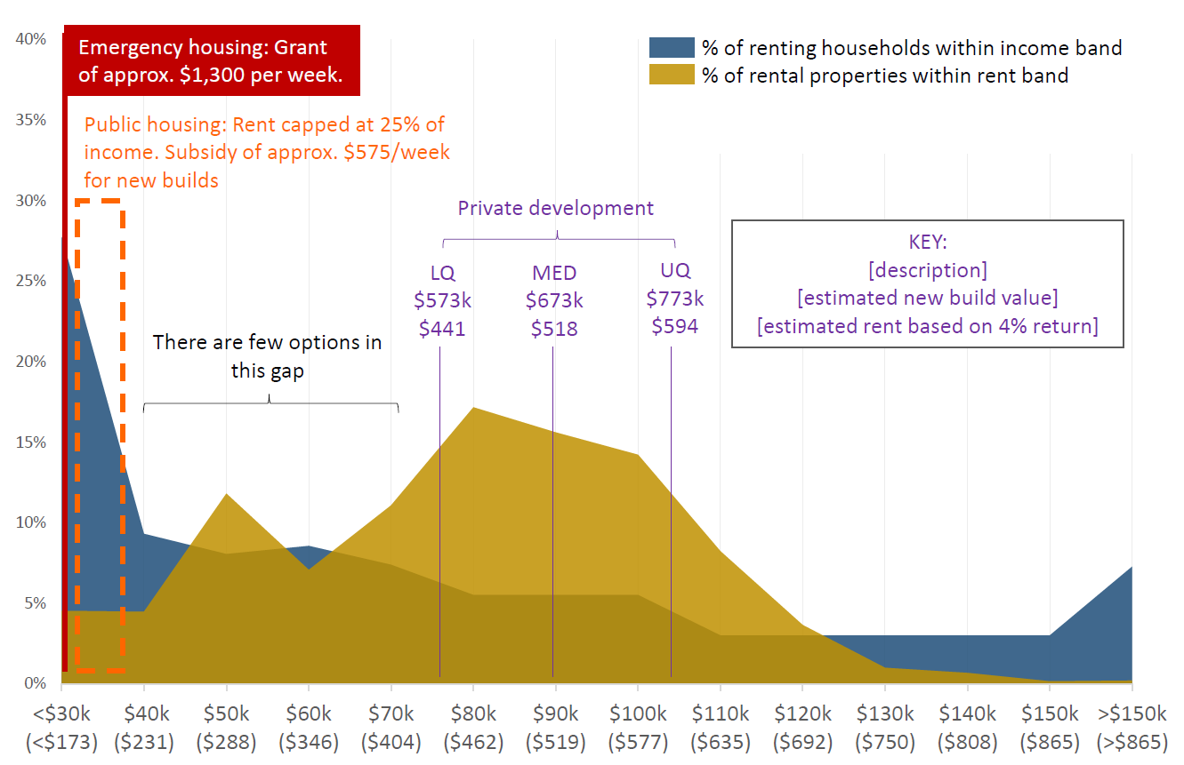
Size of the challenge – Waikato example
Notes:
Replicated throughout NZ
Biggest institutional and legislative change to housing and urban development for a generation.
Partnerships will be critical to making this work. Kāinga Ora will partner with developers, councils, community, Māori, government agencies, and others to facilitate and deliver urban development projects.
It’s about transforming whole communities. Development projects will provide people with good quality, public, affordable and market homes that connect to the jobs, transport networks, open spaces and facilities needed for communities to thrive.
Kāinga Ora will also play an essential role in tackling the Government’s priorities of ending homelessness and making homes in New Zealand more affordable.

Slide 10
https://www.waikatohousinginitiative.org/
Notes:
- Kāinga Ora is leading the largest urban regeneration ever undertaken in New Zealand, a multi-billion dollar programme that will transform suburbs and communities across the country.
- Large-scale developments are currently underway in Auckland’s Hobsonville Point, Northcote, Mt Roskill, Oranga and Mangere. We are also working alongside Tāmaki Regeneration Company to deliver more homes to Point England, Panmure and Glen Innes in Auckland’s east; and we are working in partnership with Porirua City Council and Ngāti Toa Rangatira to undertake a large scale regeneration project in Porirua.
- As well as increasing the supply of new quality housing including more affordable homes, these projects will create improved infrastructure, more connected neighbourhoods and better amenities.

Slide 11
Working with the construction sector
Redevelop our own properties
Commission developers to supply market ready homes
Partnering with developers / Iwi to enable larger-scale developments (underwriting / off-take etc)
Specified Development Projects - Partnering with communities and developers on large scale urban development and regeneration projects (Hobsonville point)
Partnering with Government / Iwi around land acquisition opportunities, including the provision of infrastructure to enable residential utilisation
Consentium - BCA
Notes:
5% to 90-95%
- Kāinga Ora is leading the largest urban regeneration ever undertaken in New Zealand, a multi-billion dollar programme that will transform suburbs and communities across the country.
- Large-scale developments are currently underway in Auckland’s Hobsonville Point, Northcote, Mt Roskill, Oranga and Mangere. We are also working alongside Tāmaki Regeneration Company to deliver more homes to Point England, Panmure and Glen Innes in Auckland’s east; and we are working in partnership with Porirua City Council and Ngāti Toa Rangatira to undertake a large scale regeneration project in Porirua.
- As well as increasing the supply of new quality housing including more affordable homes, these projects will create improved infrastructure, more connected neighbourhoods and better amenities.

Slide 12
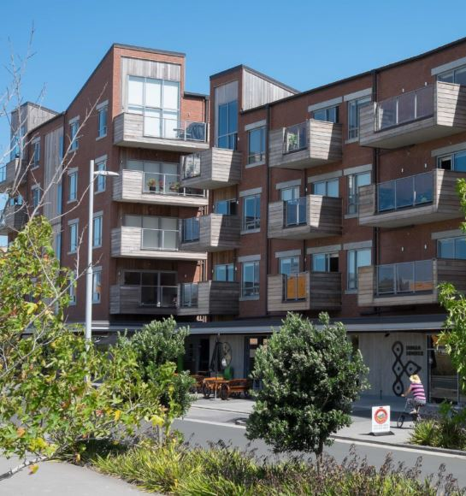
Five key aspects relevant to regions
National Policy Statement on Urban Development (NPS-UD)
Housing Acceleration Fund
Māori housing funding
Regional investment plans
Social procurement
Notes:
5% to 90-95%
- Kāinga Ora is leading the largest urban regeneration ever undertaken in New Zealand, a multi-billion dollar programme that will transform suburbs and communities across the country.
- Large-scale developments are currently underway in Auckland’s Hobsonville Point, Northcote, Mt Roskill, Oranga and Mangere. We are also working alongside Tāmaki Regeneration Company to deliver more homes to Point England, Panmure and Glen Innes in Auckland’s east; and we are working in partnership with Porirua City Council and Ngāti Toa Rangatira to undertake a large scale regeneration project in Porirua.
As well as increasing the supply of new quality housing including more affordable homes, these projects will create improved infrastructure, more connected neighbourhoods and better amenities.
The UDA is one of our commercial and urban development tools, alongside the Kāinga Ora – Homes and Comunities Act 2019
- Kāinga Ora is leading the largest urban regeneration ever undertaken in New Zealand, a multi-billion dollar programme that will transform suburbs and communities across the country.
- Large-scale developments are currently underway in Auckland’s Hobsonville Point, Northcote, Mt Roskill, Oranga and Mangere. We are also working alongside Tāmaki Regeneration Company to deliver more homes to Point England, Panmure and Glen Innes in Auckland’s east; and we are working in partnership with Porirua City Council and Ngāti Toa Rangatira to undertake a large scale regeneration project in Porirua.
- As well as increasing the supply of new quality housing including more affordable homes, these projects will create improved infrastructure, more connected neighbourhoods and better amenities.
Government wellbeing focus and procurement rules
Targets for new apprentices/cadets
Māori contractors/subbies
Leading construction industry by example
Partnering directly with Māori
Focus on local
Each $1M spend = approx 6FTE (fyi stat from Gareth Stiven)
Kāinga Ora has targets of 100 new apprentices/cadets a year – easily surpassing. Kāinga Ora’s social procurement is set up in Auckland and Christchurch, on its way in Wellington and Te Tai Tokerau, rolling out to regions
Social procurement is good for the industry, community and environment

Slide 13
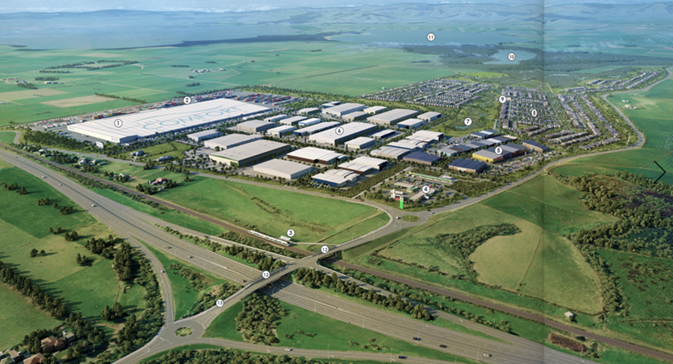
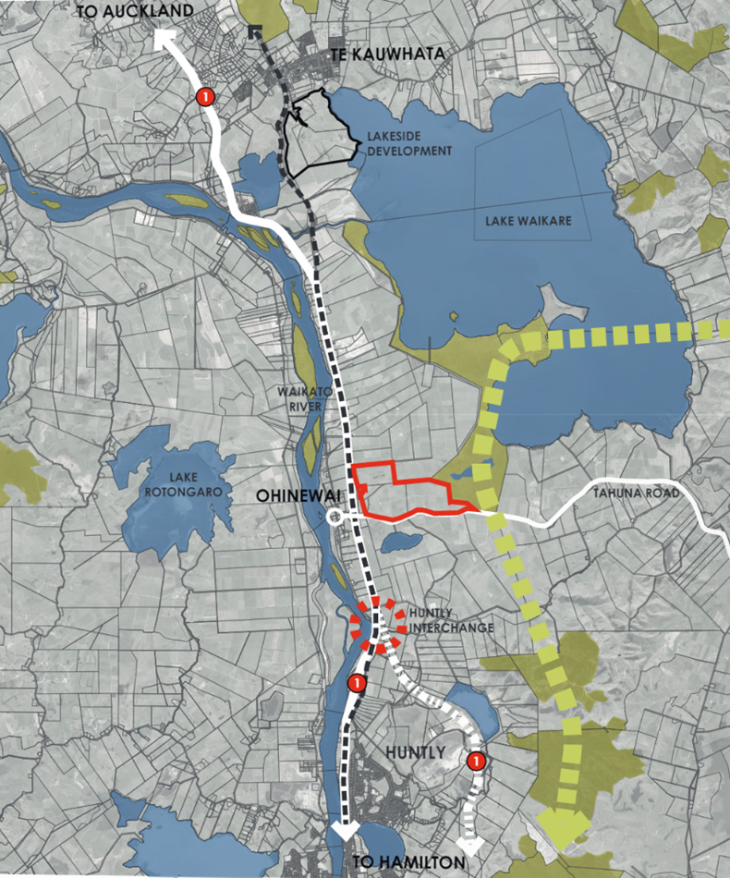
Economic development and housing Waikato example
www.sleepyheadestate.co.nz
Notes:
Size / scale
Drivers for comfort group
Driver for others
Hamilton – Auckland corridor
Express way
Rail – Te Huia
Taupri – Te Kuwhata – Huntly opportunity
Regeneration Plan
KO – Te Kuwhata
Hopuhopu to South
Iwi opportunities

Slide 14
Questions and discussion
Ngā mihi
Mark Rawson
Regional Director Waikato
Kāinga Ora – Homes and Communities
Mark.Rawson@kaingaora.govt.nz
Notes:
What is the role / opportunity for regional economic development in enabling solutions to the Housing crisis?

